Slide 1

Deep Reinforcement Learning in a Handful of Trials with Probabilistic Dynamics Models
Kurtland Chua, Roberto Calandra, Rowan McAllister, Sergey Levine
University of California, Berkeley

Slide 2
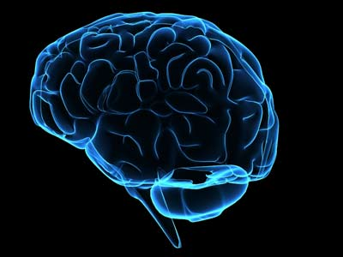
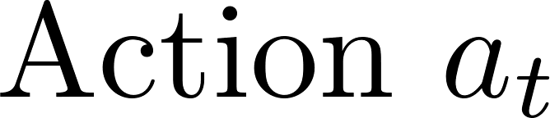
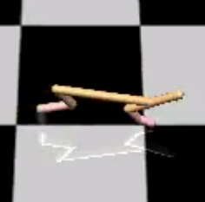
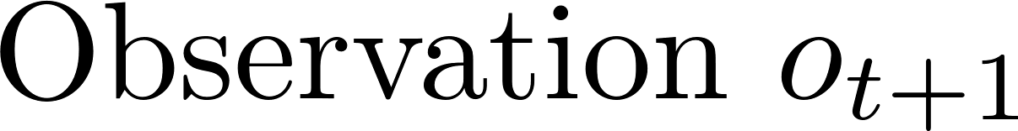
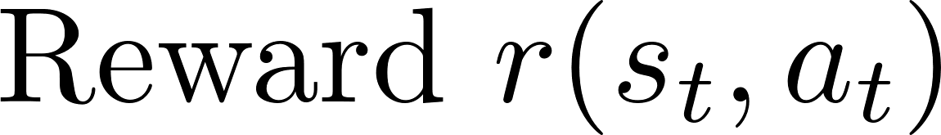
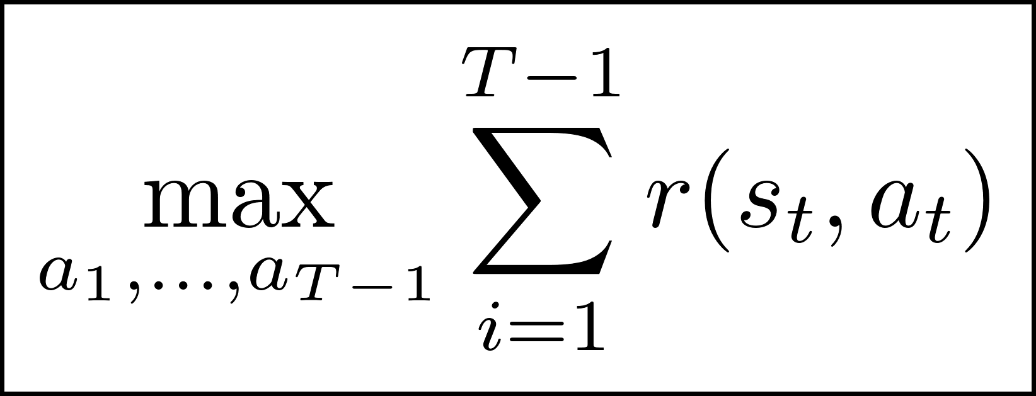
What is Reinforcement Learning?

Slide 3

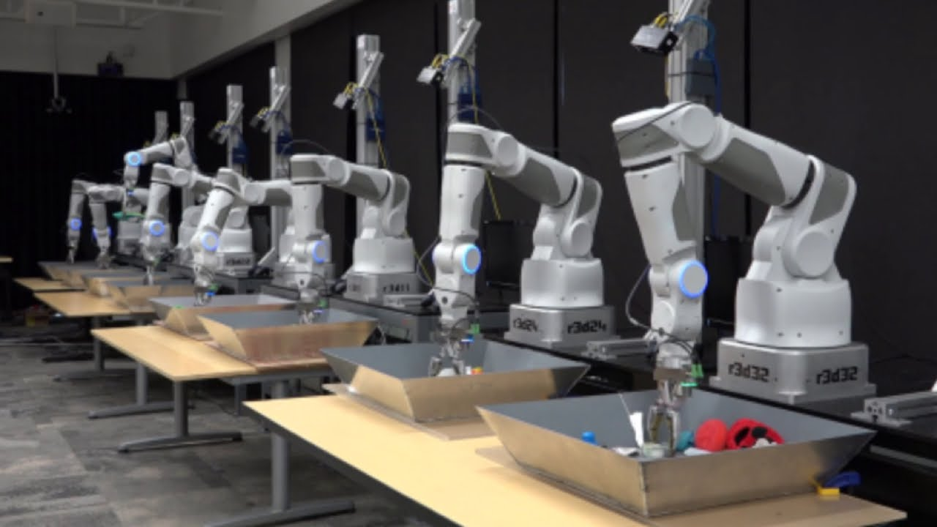
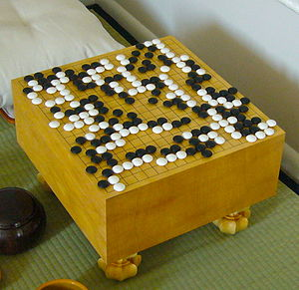

Slide 4
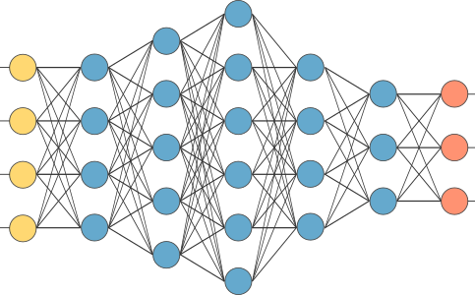
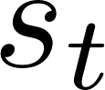
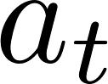
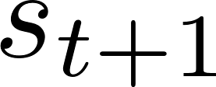
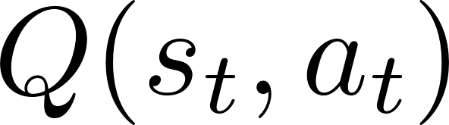
Current Approaches to Reinforcement Learning
Policy Gradients
PPO, TRPO
Actor-Critic
SAC, DDPG
Model-based RL
MBMF
(Schulman et al. ‘15, Schulman et al. ‘17)
(Haarnoja et al., Lillicrap et al.)
(Nagabandi et al.)
Least Efficient
Most efficient
Data Efficiency

Slide 5

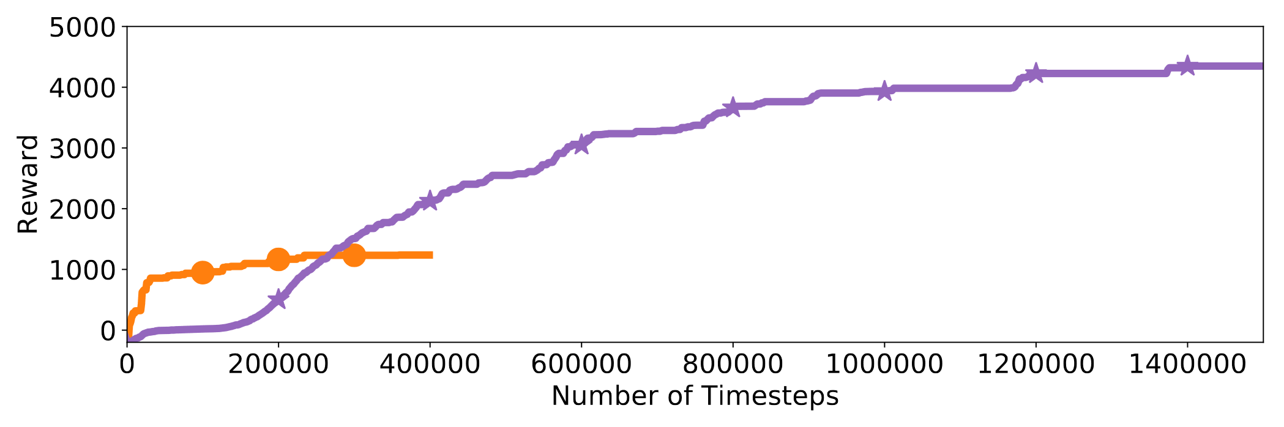
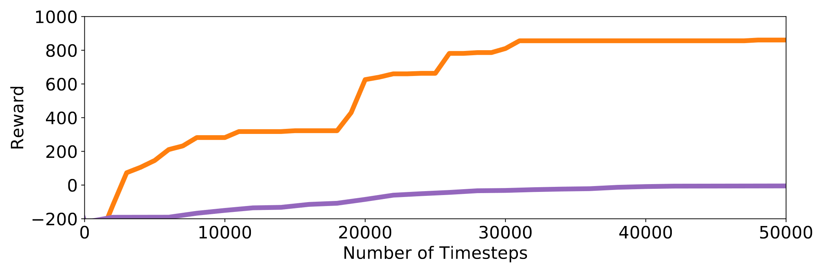
Comparative Performance on HalfCheetah
8 hours of interaction!

Slide 6

Model-based Reinforcement Learning
Environment Interaction
Generate
action sequences
Train dynamics model
Predict expected reward for every sequence using the model
Apply first action from best sequence

Slide 7
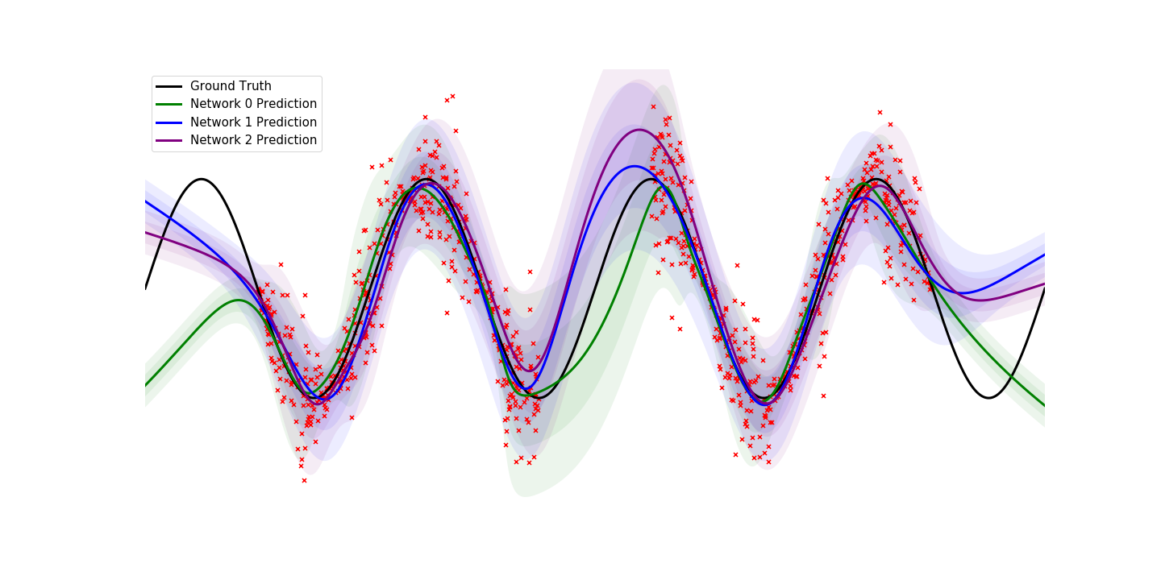
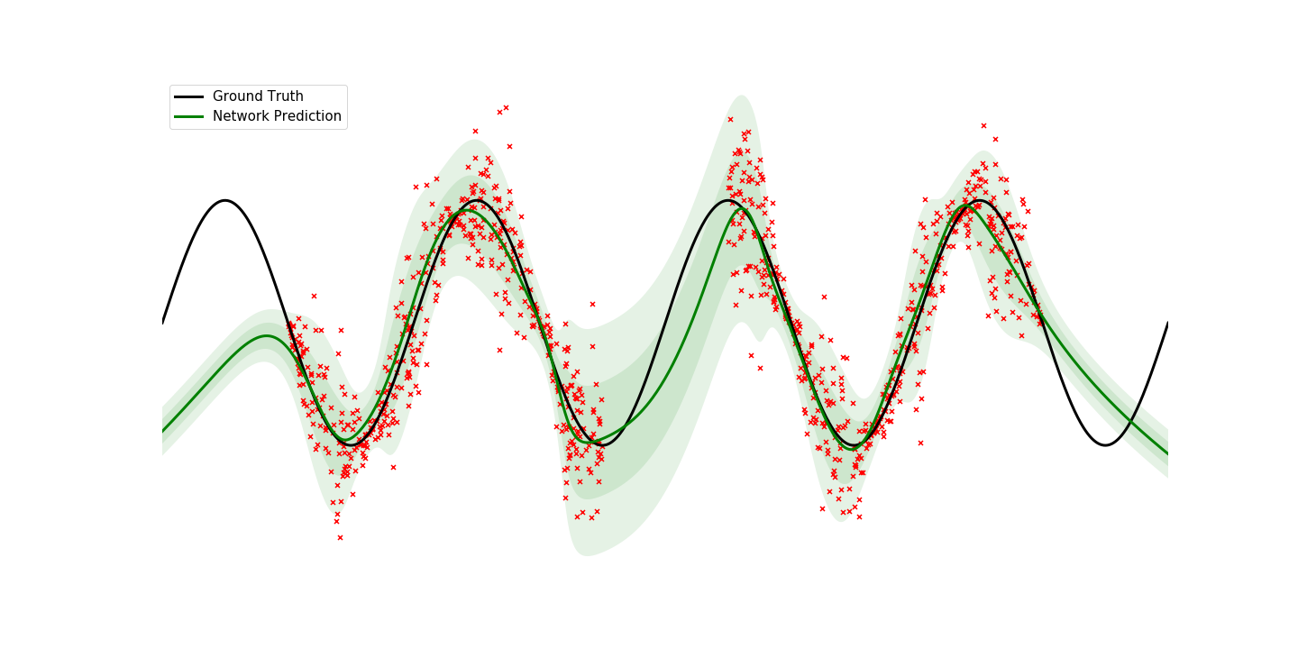
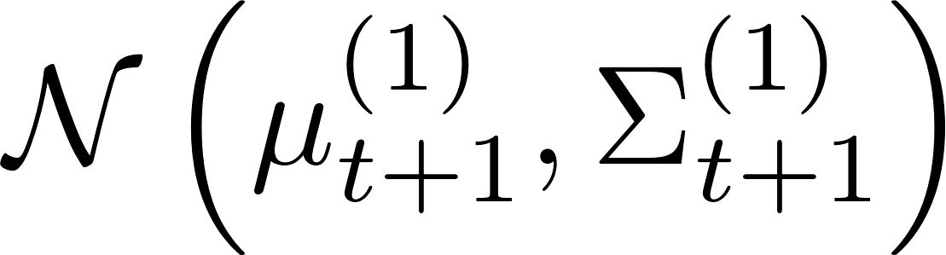
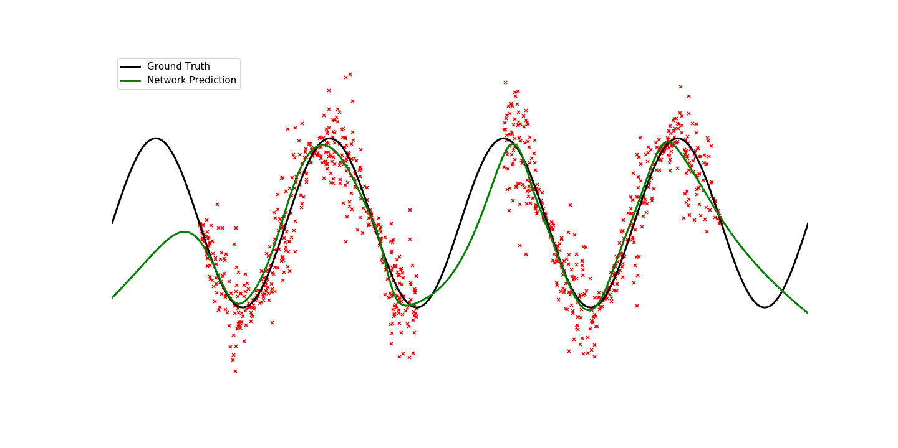
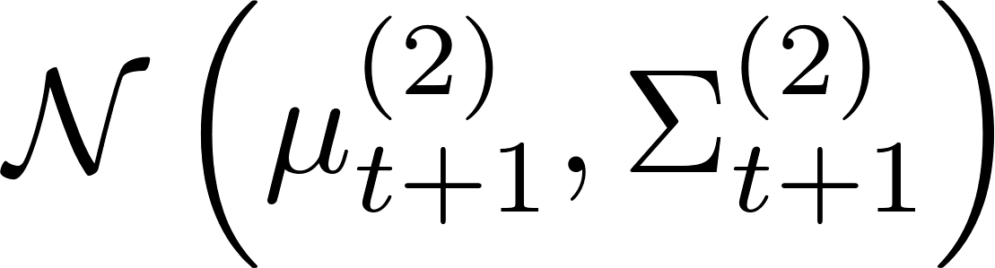
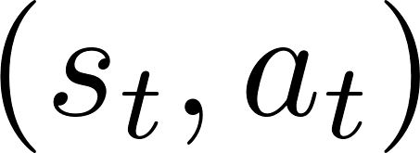
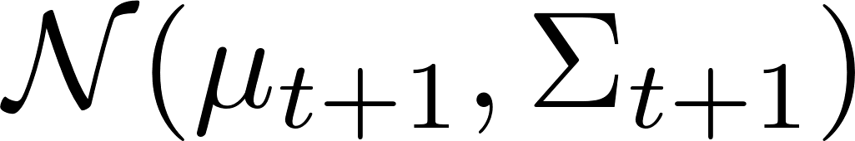
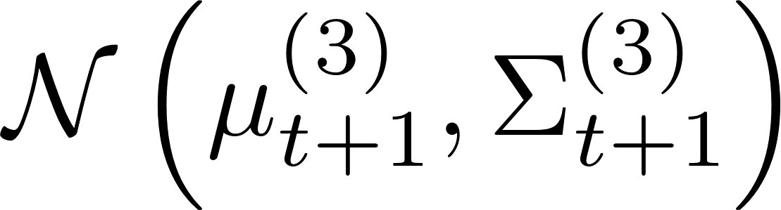
Probabilistic Ensembles as Models
Deterministic Neural Nets as Models
Probabilistic Neural Nets as Models

Slide 8
Model-based Reinforcement Learning
Environment Interaction
Generate
action sequences
Train a probabilistic ensemble model
Train dynamics model
Predict expected reward for every sequence using the model
Apply first action from best sequence

Slide 9
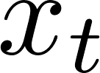
Trajectory Sampling for State Propagation

Slide 10
Model-based Reinforcement Learning
Our Method: Probabilistic Ensembles with Trajectory Sampling (PETS)
Environment Interaction
Generate
action sequences
Train a probabilistic ensemble model
Train dynamics model
Use trajectory sampling to predict action sequence reward
Predict expected reward for every sequence using the model
Apply first action from best sequence

Slide 11
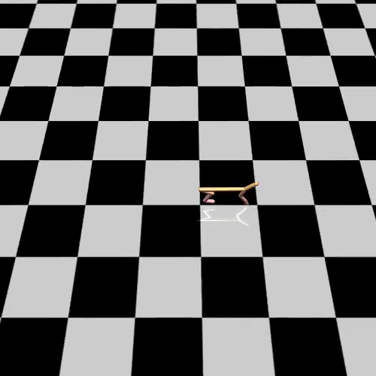
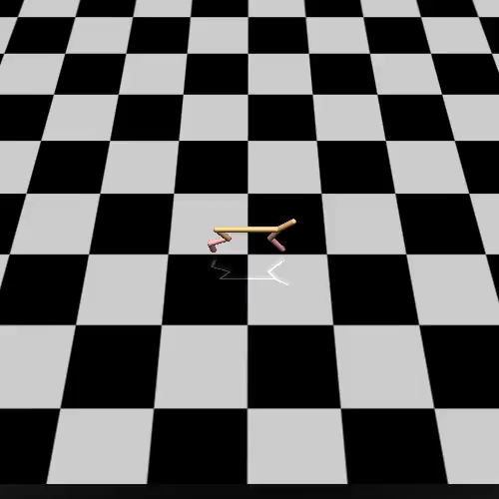


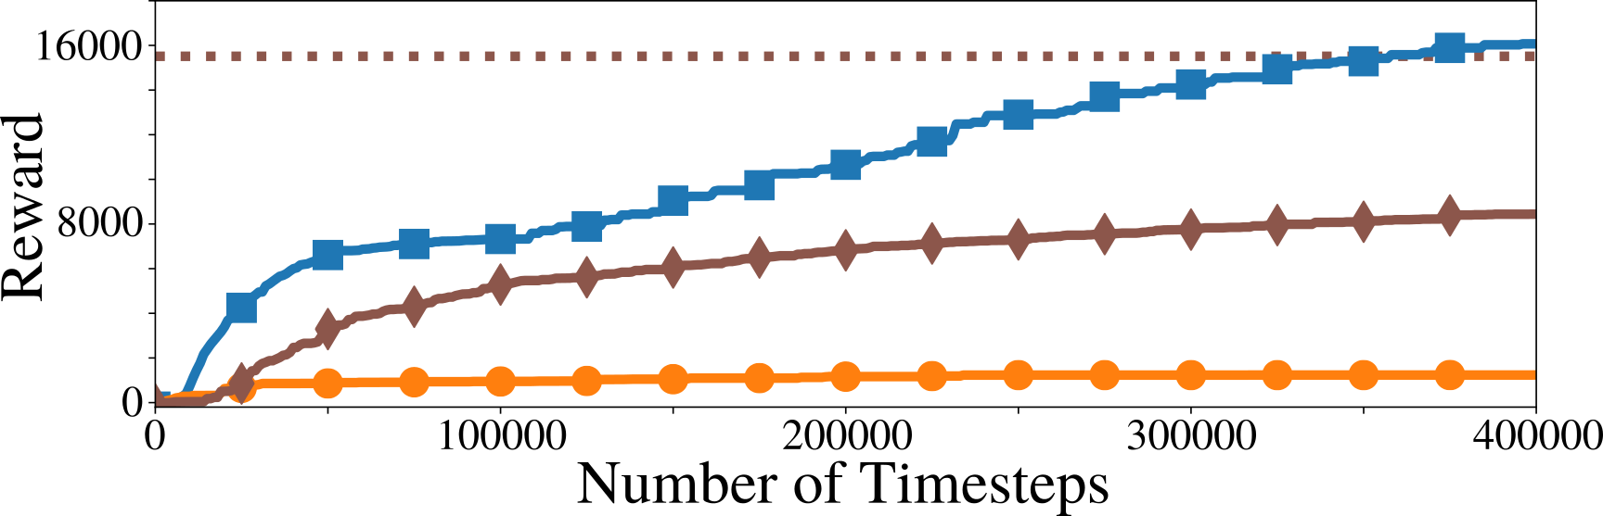
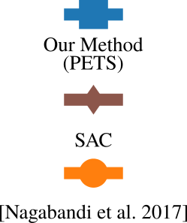
Experimental Results
PETS

Slide 12
Why use PETS?
Data efficiency
Competitive asymptotic performance
Ease of implementation

Slide 13
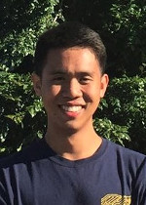
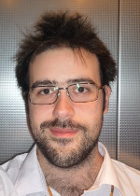
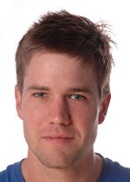
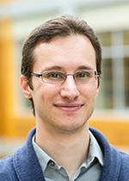
Deep Reinforcement Learning in a Handful of Trials with Probabilistic Dynamics Models
Code:
Website:
Paper:
https://github.com/kchua/handful-of-trials
https://sites.google.com/view/drl-in-a-handful-of-trials
https://arxiv.org/abs/1805.12114
Kurtland Chua
Roberto Calandra
Rowan McAllister
Sergey Levine

